Slide 1

Chennai Housing Price Prediction
By Sowndarya
Ijas Muhammed
Thanushree
Vignesh
Lokesh
Alankrat gupta

Slide 2
ABOUT THE DATASET
Real estate transactions are quite opaque sometimes and it may be difficult for a newbie to know the fair price of any given home. Thus, multiple real estate websites have the functionality to predict the prices of houses given different features regarding it. Such forecasting models will help buyers to identify a fair price for the home and also give insights to sellers as to how to build homes that fetch them more money. Chennai house sale price data is shared here and the participants are expected to build a sale price prediction model that will aid the customers to find a fair price for their homes and also help the sellers understand what factors are fetching more money for the houses?

Slide 3
Features :
PRT_ID
Id of house
AREA
In which area house is location
INT_SQFT
Area in sq ft
DATE_SALE
When house was sold
DIST_MAINROAD
Distance of house from main road
N_BEDROOMS
Number of Bedrooms

Slide 4

DIST_MAINROAD
Distance of house from main road
N_BEDROOMS
Number of Bedrooms
N_BATHROOM
Number of Bathrooms
N_ROOMS
NUMBER OF ROOMS
SALE_COND
Sale condition

Slide 5

PARK_FACIL
Is parking available or not
DATE_BUILD
Date house was built
BUILDTYPE
Purpose of house
UTILITY_AVAIL
Facilities available there
STREET
How is street outside that house

Slide 6

MZZONE
Which zone it is in
QS_ROOMS
It is masked data
QS_BATHROOM
It is masked data
QS_BEDROOM
It is masked data
QS_OVERALL
It is masked data

Slide 7

REG_FEE
Registration fee after sales
COMMIS
Commission fee after sales
SALES_PRICE
Sale price of house

Slide 8
Checking For Null Values
Missing Data is a very big problem in a real-life scenarios.
Missing Data can also refer to as NA(not available) values in pandas.
In order to check missing values in pandas Dataframe here we used a function isnull()
Here we got only small amout of missing values.so we replaced with mean value of the columns using simpleimputer.

Slide 9

Data cleaning
Changing Spelling
Here we can observe that In the area column have lot of spelling mistakes are there.so we changed the correct spelling
This problem is present in almost all the categorical columns so the spellings should be corrected,else it results in creation of more columns while encoding the data during data preprocessing
Data type changing
In this dataset we observed that some of the features data type irrelevant to that. so, we changed the data type of the features

Slide 10
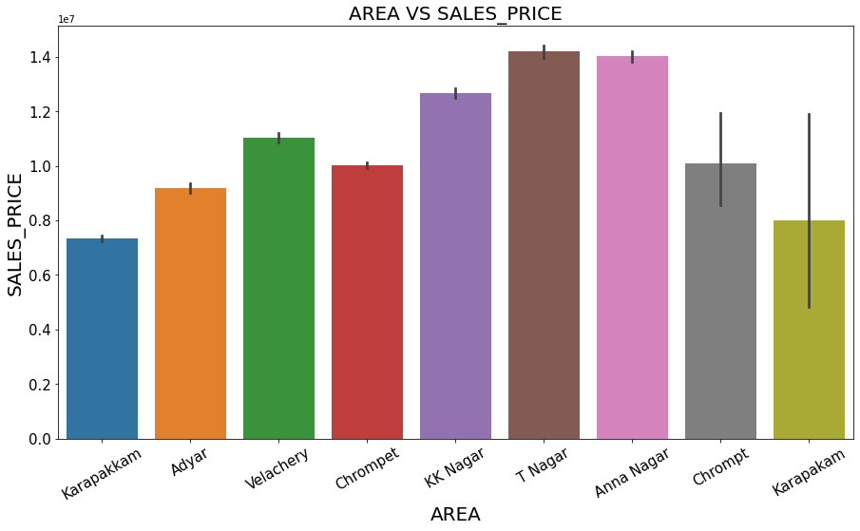
Exploratory Data Analysis
How the Sales Price of Houses varies with Different Areas in Chennai ?
T Nagar and Anna Nagar Area Houses Has Maximum Sales Price and KK Nagar Area Houses are second Max Sales Price
Karapakam Area Houses has Less Sales Price When Compared to other Area Houses

Slide 11
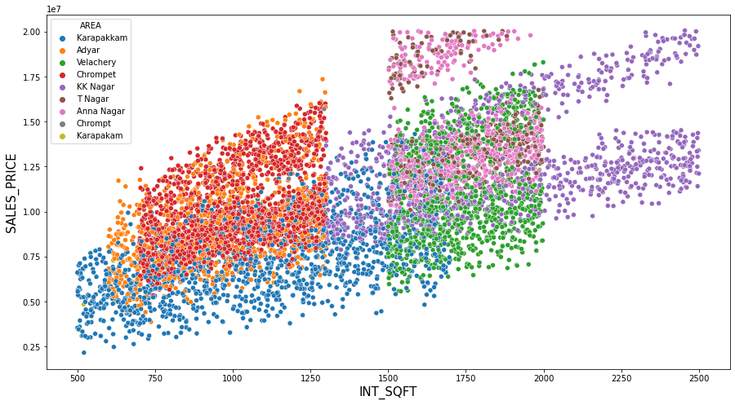
How the Square Foot of the House will Effect the Sales Price?
Increase in Square Foot of Houses increases the Sales price of Houses
As we can see the Houses Related to Same Area Having Almost Similar Square feet Length
T Nagar and Anna Nagar Area Houses has Maximum Price Having Square Foot in the Range of 1500 to 2000
KK Nagar Area Houses Has high Square foots from 1400 to 2500

Slide 12
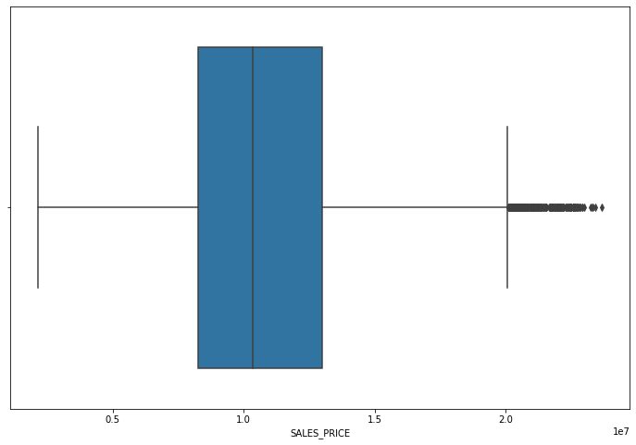
Checking for outliers
Here we checked the outliers for our target sales price columns.
We observed that the lot of out outliers present in the sales price columns.
So, some of the methods to treated By
Interquartile R
Z –Score Method
Using Standard Deviation

Slide 13

Data Pre-processing
After treating all the outliers, and removing the Null values.
We are going for all the necessary Feature Engineering .So, that we can get a simplified Data.
We have to Convert all the ‘Categorical’ or ‘Object’ datatypes to ‘Numeric’ using label encoder. further go for Model Building having ‘Price’ as the Target Variable and remaining as Independent Variables.
Then Finally after Scaling the data using Standard Scaler we will go for Model Building using all the Necessary Algorithms.

Slide 14
Model building
After doing all the necessary steps our dataset for training the multiple regression
Algorithm.
Here we create the models on 5 different algorithm
LinearRegression
DecisionTreeRegressor
RandomForestRegressor
KNeighborsRegressor
XGBRegressor

Slide 15
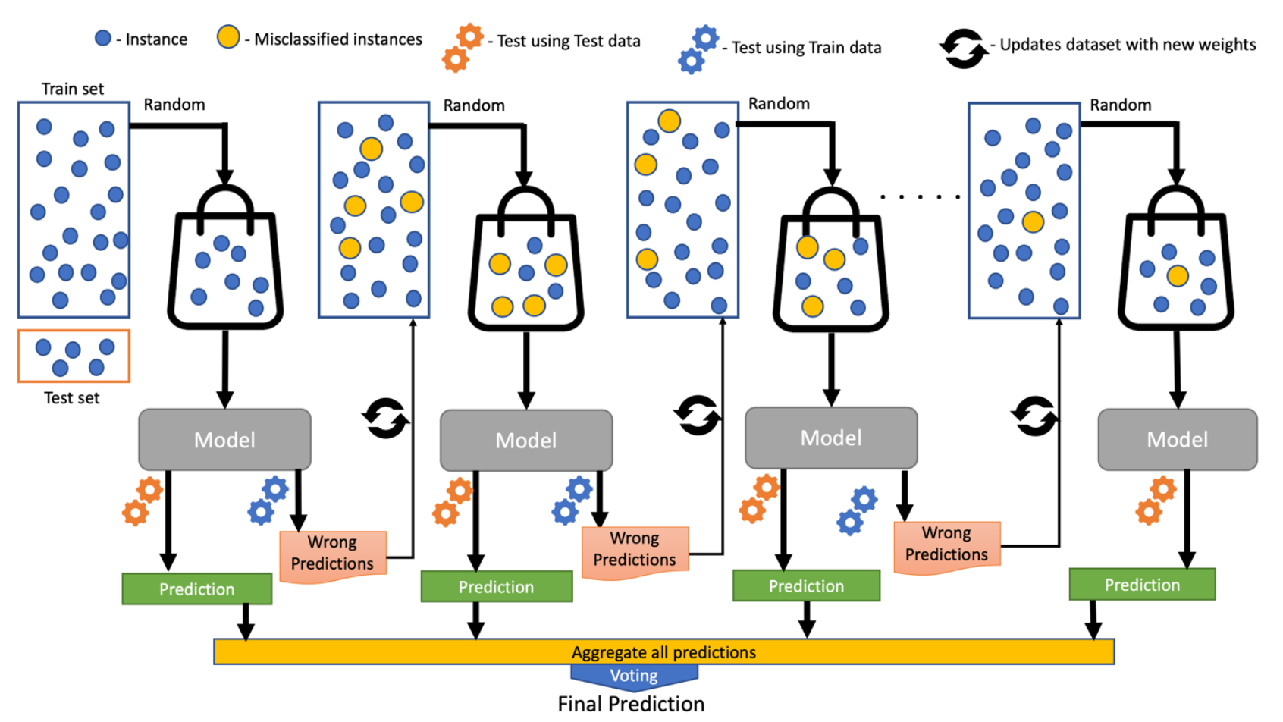
Final Conclusion
This was an incredibly learning experience iterating on building a predictive House Price model.
By building model using “XGBRegressor” we got the model with lowest “RMSE” of 0.13 and “r2_score Accuracy of 98.30%. So, we can conclude that our “House Price Model” is accurate as predicted.
So from the data we can get the proper Price of house as per our Requirement.
And in Future with the new data the model should perform good

Slide 16


